Slide 1
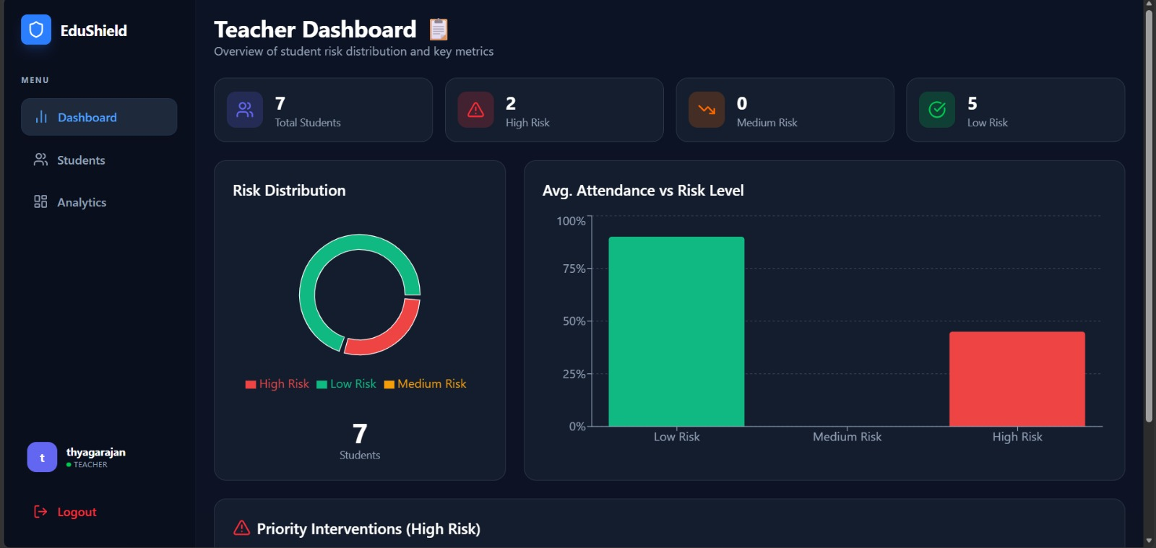
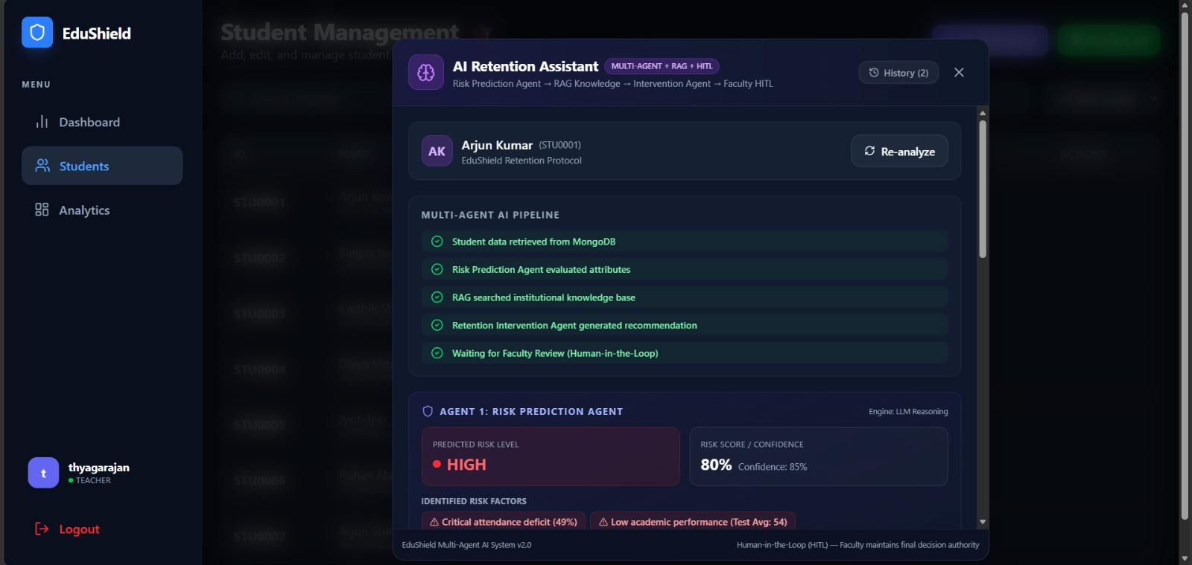
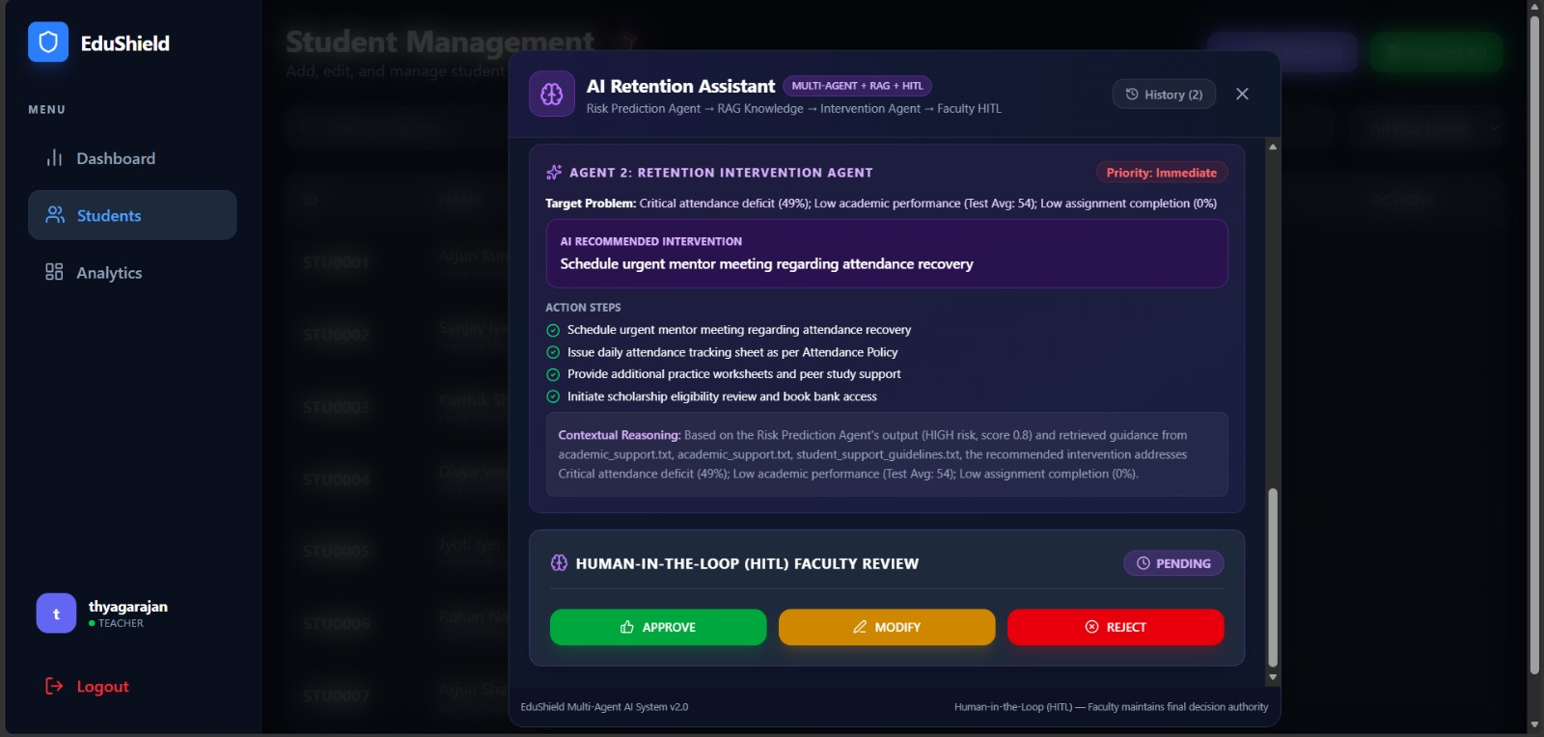
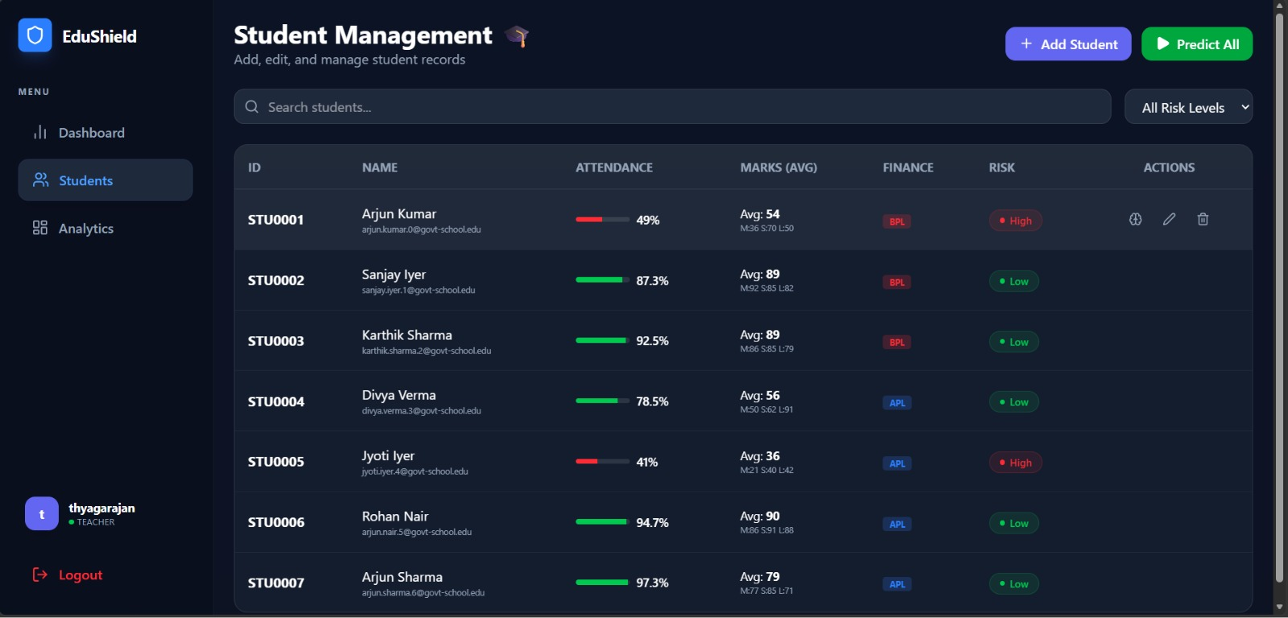
DEPARTMENT OF ARTIFICIAL INTELLIGENCE AND MACHINE LEARNING
EduShield: A Multi-Agent Agentic AI System for Student Retention and Personalized Intervention with RAG and Human-in-the-Loop
Team Members
[Member 1 – Name (Reg. No.)]
[Member 2 – Name (Reg. No.)]
[Member 3 – Name (Reg. No.)]

Slide 2
1
Problem Statement
Problem Definition
Real-World Context
Schools identify at-risk students only after performance has already dropped.
Attendance, marks and assignment data are scattered across records.
Traditional ML gives a risk label but not the action to take.
Faculty must manually analyse many factors to choose an intervention.
Support guidelines and policies are not linked to each student’s case.
Need: predict risk, explain why, and recommend a policy-backed action.
Government and private schools, colleges
Teachers and mentors
Counsellors and student support teams
Academic advisors
Administrators tracking retention
Students from varied backgrounds (e.g., BPL / APL categories)
Final review
Department of Artificial Intelligence and Machine Learning

Slide 3
2
User and Stakeholder Analysis
Target Users
Stakeholder Identification
Teacher – primary user
Counsellor
Student
Administrator / Institution
Stakeholder | Main Need
Teacher | Spot high-risk students early; review and approve AI recommendations
Counsellor | Understand risk factors; coordinate support actions
Student | Timely support; AI counselling chatbot access
Administrator | Risk distribution and retention analytics
Final review
Department of Artificial Intelligence and Machine Learning

Slide 4
3
Proposed System: Analysis Pipeline
Turns a student’s records into a risk assessment and a policy-grounded intervention, with faculty making the final decision.
1 Student Data
2 Risk Prediction Agent
3 RAG Retrieval
Attendance, marks, assignments retrieved from MongoDB.
Evaluates attributes; outputs risk level, score and confidence.
Searches institutional knowledge base for relevant guidance.
4 Intervention Agent
5 Faculty HITL
6 Re-analyze + History
Generates priority, target problem, action steps and reasoning.
Teacher approves, modifies or rejects the recommendation.
Re-run with updated data; past analyses are kept.
Final review
Department of Artificial Intelligence and Machine Learning

Slide 5
4
Proposed System: Data Sources
Student Records
Assignments
Knowledge Base
Model Outputs
Analysis History
MongoDB: ID, name, attendance %, subject marks (M / S / L), average, finance category.
Assignment completion % (e.g., 0% for STU0001).
academic_support.txt, student_support_guidelines.txt, Attendance Policy.
Risk level, risk score (0.8 = 80%), confidence (85%).
Previous AI analyses saved per student (History).
Demo dataset: 7 students (STU0001 – STU0007), 2 High / 0 Medium / 5 Low risk.
Final review
Department of Artificial Intelligence and Machine Learning

Slide 6
5
Tools and Technologies Used
Layer | Technologies / Tools
1 User Layer | Web dashboard (Teacher, Counsellor, Student roles); Charts for analytics
2 Backend Layer | Node.js, Express.js, REST APIs
3 Security | JWT authentication, role-based login
4 Agent Layer | Risk Prediction Agent + Retention Intervention Agent (LLM reasoning)
5 ML Layer | ML-based risk prediction (XGBoost) — confirm
6 Knowledge Layer | RAG over institutional text documents
7 Data Layer | MongoDB / MongoDB Atlas
Final review
Department of Artificial Intelligence and Machine Learning

Slide 7
6
Agents Architecture
MongoDB
Student Data
→
Agent 1
Risk Prediction
→
RAG
Knowledge Base
→
Agent 2
Retention Intervention
→
Faculty HITL
Review
Re-analyze with updated data ⟲ | Analysis History saved per student
Shared context passed between agents
Agent 1 → risk level, score, identified risk factors
RAG → guidance from academic_support.txt and student_support_guidelines.txt
Agent 2 → priority, target problem, action steps, contextual reasoning
Final review
Department of Artificial Intelligence and Machine Learning

Slide 8
7
Agents Responsibilities
Two specialised agents, a retrieval step and a human reviewer, shown as “Multi-Agent + RAG + HITL”.
Agent 1 — Risk Prediction
RAG — Knowledge Retrieval
Evaluates student attributes
Outputs risk level, score, confidence
Lists risk factors (e.g., attendance 49%)
Searches institutional knowledge base
Returns relevant policy and guideline text
Grounds the recommendation
Agent 2 — Retention Intervention
Faculty — HITL Review
Defines target problem and priority
Generates recommended intervention
Lists action steps with reasoning
Status: Pending until reviewed
Approve, Modify or Reject
Faculty keeps final decision authority
Final review
Department of Artificial Intelligence and Machine Learning

Slide 9
8
Agent Workflow and Orchestration
Teacher opens AI Analysis
→
Student data from MongoDB
→
Risk Agent evaluates
→
RAG searches knowledge
→
Intervention Agent recommends
→
Waiting for Faculty Review
Pipeline status shown live in the dashboard
Faculty decision
APPROVE
MODIFY
REJECT
Re-analyze reruns the whole pipeline with updated student data
Final review
Department of Artificial Intelligence and Machine Learning

Slide 10
9
Orchestration
1 Data Layer
2 Agent Layer
3 Human Layer
MongoDB stores student records
Attendance, marks, finance category
Assignment completion
Saved analysis history
Agent 1 predicts risk
RAG retrieves institutional guidance
Agent 2 builds intervention plan
Output shows engine: LLM reasoning
Faculty reviews every recommendation
Approve / Modify / Reject
Footer: “Faculty maintains final decision authority”
JWT-secured access by role
Final review
Department of Artificial Intelligence and Machine Learning

Slide 11
10
System Architecture: Tiered View
1 User Layer
2 API Layer
3 Agent Layer
4 Knowledge Layer
5 Data Layer
Teacher, Counsellor, Student dashboards
Node.js + Express REST, JWT auth
Risk Prediction Agent, Intervention Agent
RAG over support and policy documents
MongoDB: students, history
Human-in-the-Loop gate: every AI recommendation is reviewed by faculty before action
Final review
Department of Artificial Intelligence and Machine Learning

Slide 12
11
Agentic RAG Implementation
1 Knowledge Sources
2 How RAG is used
3 Retrieval Method
academic_support.txt
student_support_guidelines.txt
Attendance Policy
Scholarship and book bank guidance
Agent 1’s risk output forms the query
Relevant guidance is retrieved
Agent 2 grounds its plan in it
Reasoning cites the source files
[Fill in: keyword / embedding / vector DB]
Knowledge base is text-file based
Easy to extend with new policies
Final review
Department of Artificial Intelligence and Machine Learning

Slide 13
12
System Implementation
Pipeline + Risk Prediction
Intervention + HITL
Five-step status tracker
STU0001: HIGH risk, 80%, confidence 85%
Factors: attendance 49%, test avg 54
Priority: Immediate
“Schedule urgent mentor meeting…”
4 action steps; Approve / Modify / Reject
Final review
Department of Artificial Intelligence and Machine Learning

Slide 14
13
Experimental Evaluation
Risk Prediction
Agent Analysis
Test Scenarios
7 students predicted
2 High, 0 Medium, 5 Low
STU0001: 3 factors found
Attendance, marks, assignments
High: STU0001, STU0005
Low: STU0002–0004, 0006–0007
Final review
Department of Artificial Intelligence and Machine Learning

Slide 15
14
Performance & Success Metrics
80%
85%
Risk score, STU0001
Prediction confidence
49%
0%
Attendance, STU0001
Assignment completion
Model accuracy / F1: [add from training results]
High-risk averages: attendance 45%, marks 45; low-risk: 90.1% and 80.6 (from the 7-student demo data).
Final review
Department of Artificial Intelligence and Machine Learning

Slide 16
15
Comparison & Innovation
Feature | Traditional ML | LLM Chatbot | EduShield
Risk prediction | ✓ | ✗ | ✓
Risk score + confidence | ✓ | ✗ | ✓
Contextual reasoning | Limited | ✓ | ✓
Institutional knowledge (RAG) | ✗ | Limited | ✓
Personalised intervention | ✗ | ✓ | ✓
Multiple specialised agents | ✗ | ✗ | ✓
Faculty approval (HITL) | Limited | Limited | ✓
Re-analysis + history | Limited | Limited | ✓
Our Innovation
EduShield links risk prediction, policy retrieval and intervention planning in one workflow: Prediction → Explanation → Recommendation → Human decision.
Final review
Department of Artificial Intelligence and Machine Learning

Slide 17
16
Scalability & Real-World
Real-World Applicability
Scalability
Early identification of at-risk students
Attendance recovery programmes
Mentoring and counselling support
Scholarship and welfare referrals
Retention analytics for administrators
More classes, schools and districts
Larger student datasets
Extend the knowledge base with new policies
Add more indicators (behaviour, health)
Cloud deployment with MongoDB Atlas
Final review
Department of Artificial Intelligence and Machine Learning

Slide 18
17
Future Work
1. Retrieval upgrade
2. More agents
3. Improved evaluation
Hybrid / vector retrieval and larger policy corpus.
Monitoring agent that triggers re-analysis automatically.
Larger datasets, repeated experiments, faculty feedback.
4. Feedback loop
5. Notifications
6. Production deployment
Learn from Approve / Modify / Reject decisions.
Alerts to mentors, counsellors and guardians.
Scalable model serving, audit logs, fine-grained access.
Final review
Department of Artificial Intelligence and Machine Learning

Slide 19
18
Conclusion
EduShield moves from predicting risk to recommending action, with faculty in control.
retrieves student records from MongoDB
predicts risk level, score and confidence
identifies factors such as attendance 49% and test average 54
retrieves institutional guidance through RAG
generates prioritised, step-by-step interventions
keeps faculty in charge via Approve / Modify / Reject
supports re-analysis and history
secures access with JWT and role-based login
Final review
Department of Artificial Intelligence and Machine Learning

Slide 20
Thank You
EduShield – Questions & Discussion
Department of Artificial Intelligence and Machine Learning

